Slide 1
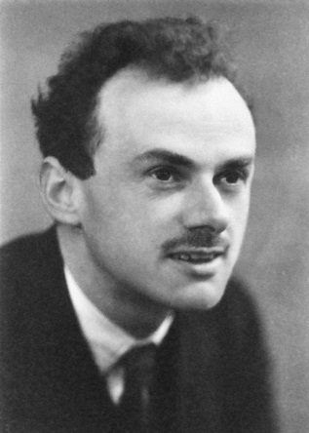
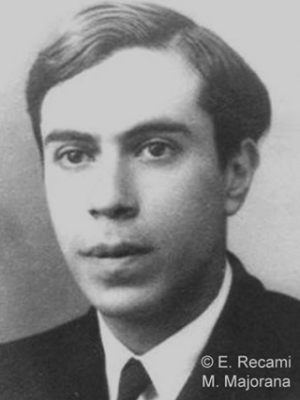
Neutrinoless Double-β Decays & ν Masses
0ν2β
2ν2β
E_{2β}
Shun Zhou (IHEP & UCAS)
Workshop on Neutrinoless Double-Beta Decays, Sun Yat-Sen University,
Zhuhai, 2021/5/21

Slide 2
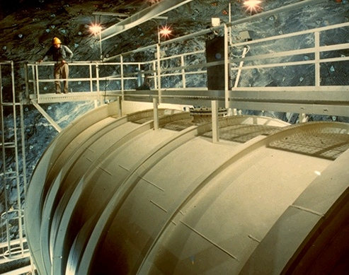
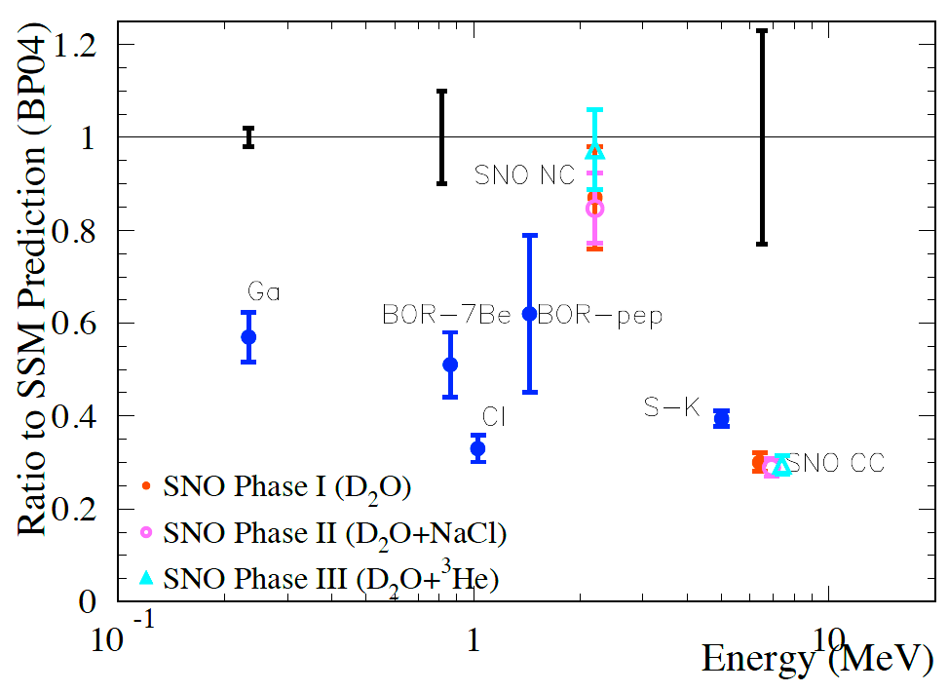
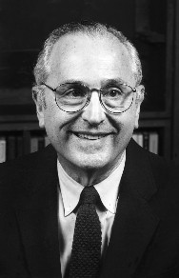
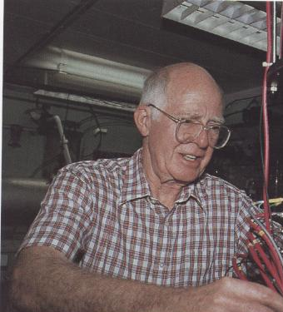
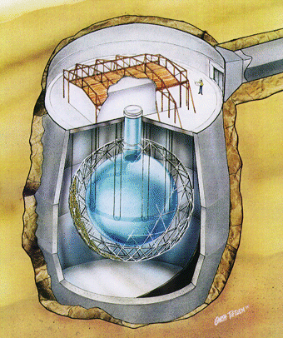
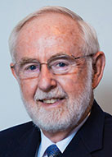

Solar Neutrino Oscillations
all ν_{x}
Homestake
ν_{e}only
J. N. Bahcall
R. Davis Jr.
Discovery of solar
neutrino oscillations
supported by
KamLAND
Phys. Rev. Lett. 55 (1985) 1534
Herbert H. Chen
陈华森
（1942-1987）
A. B. McDonald
SNO

Slide 3
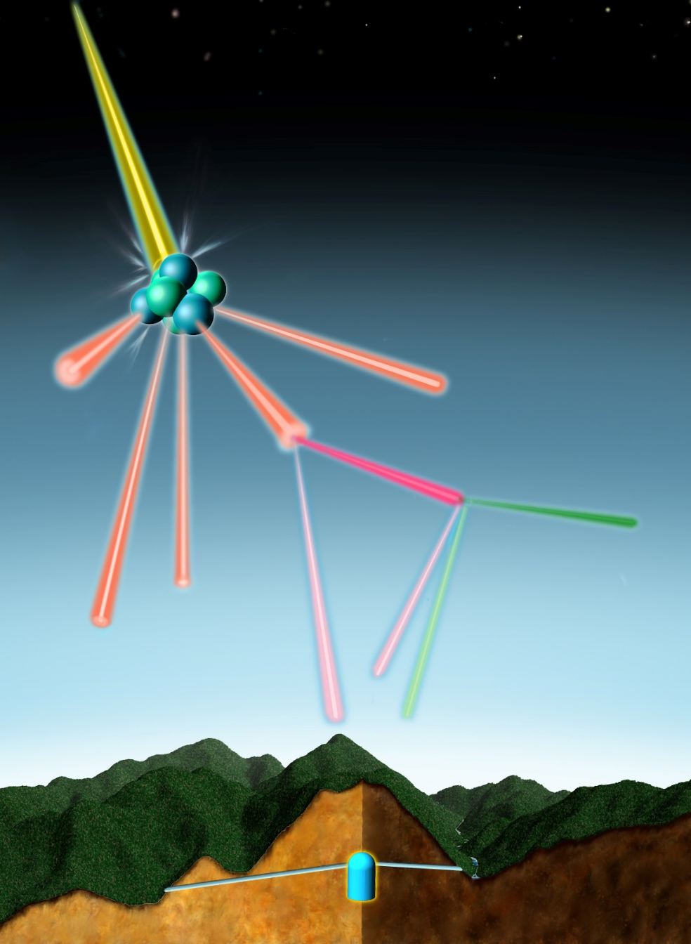
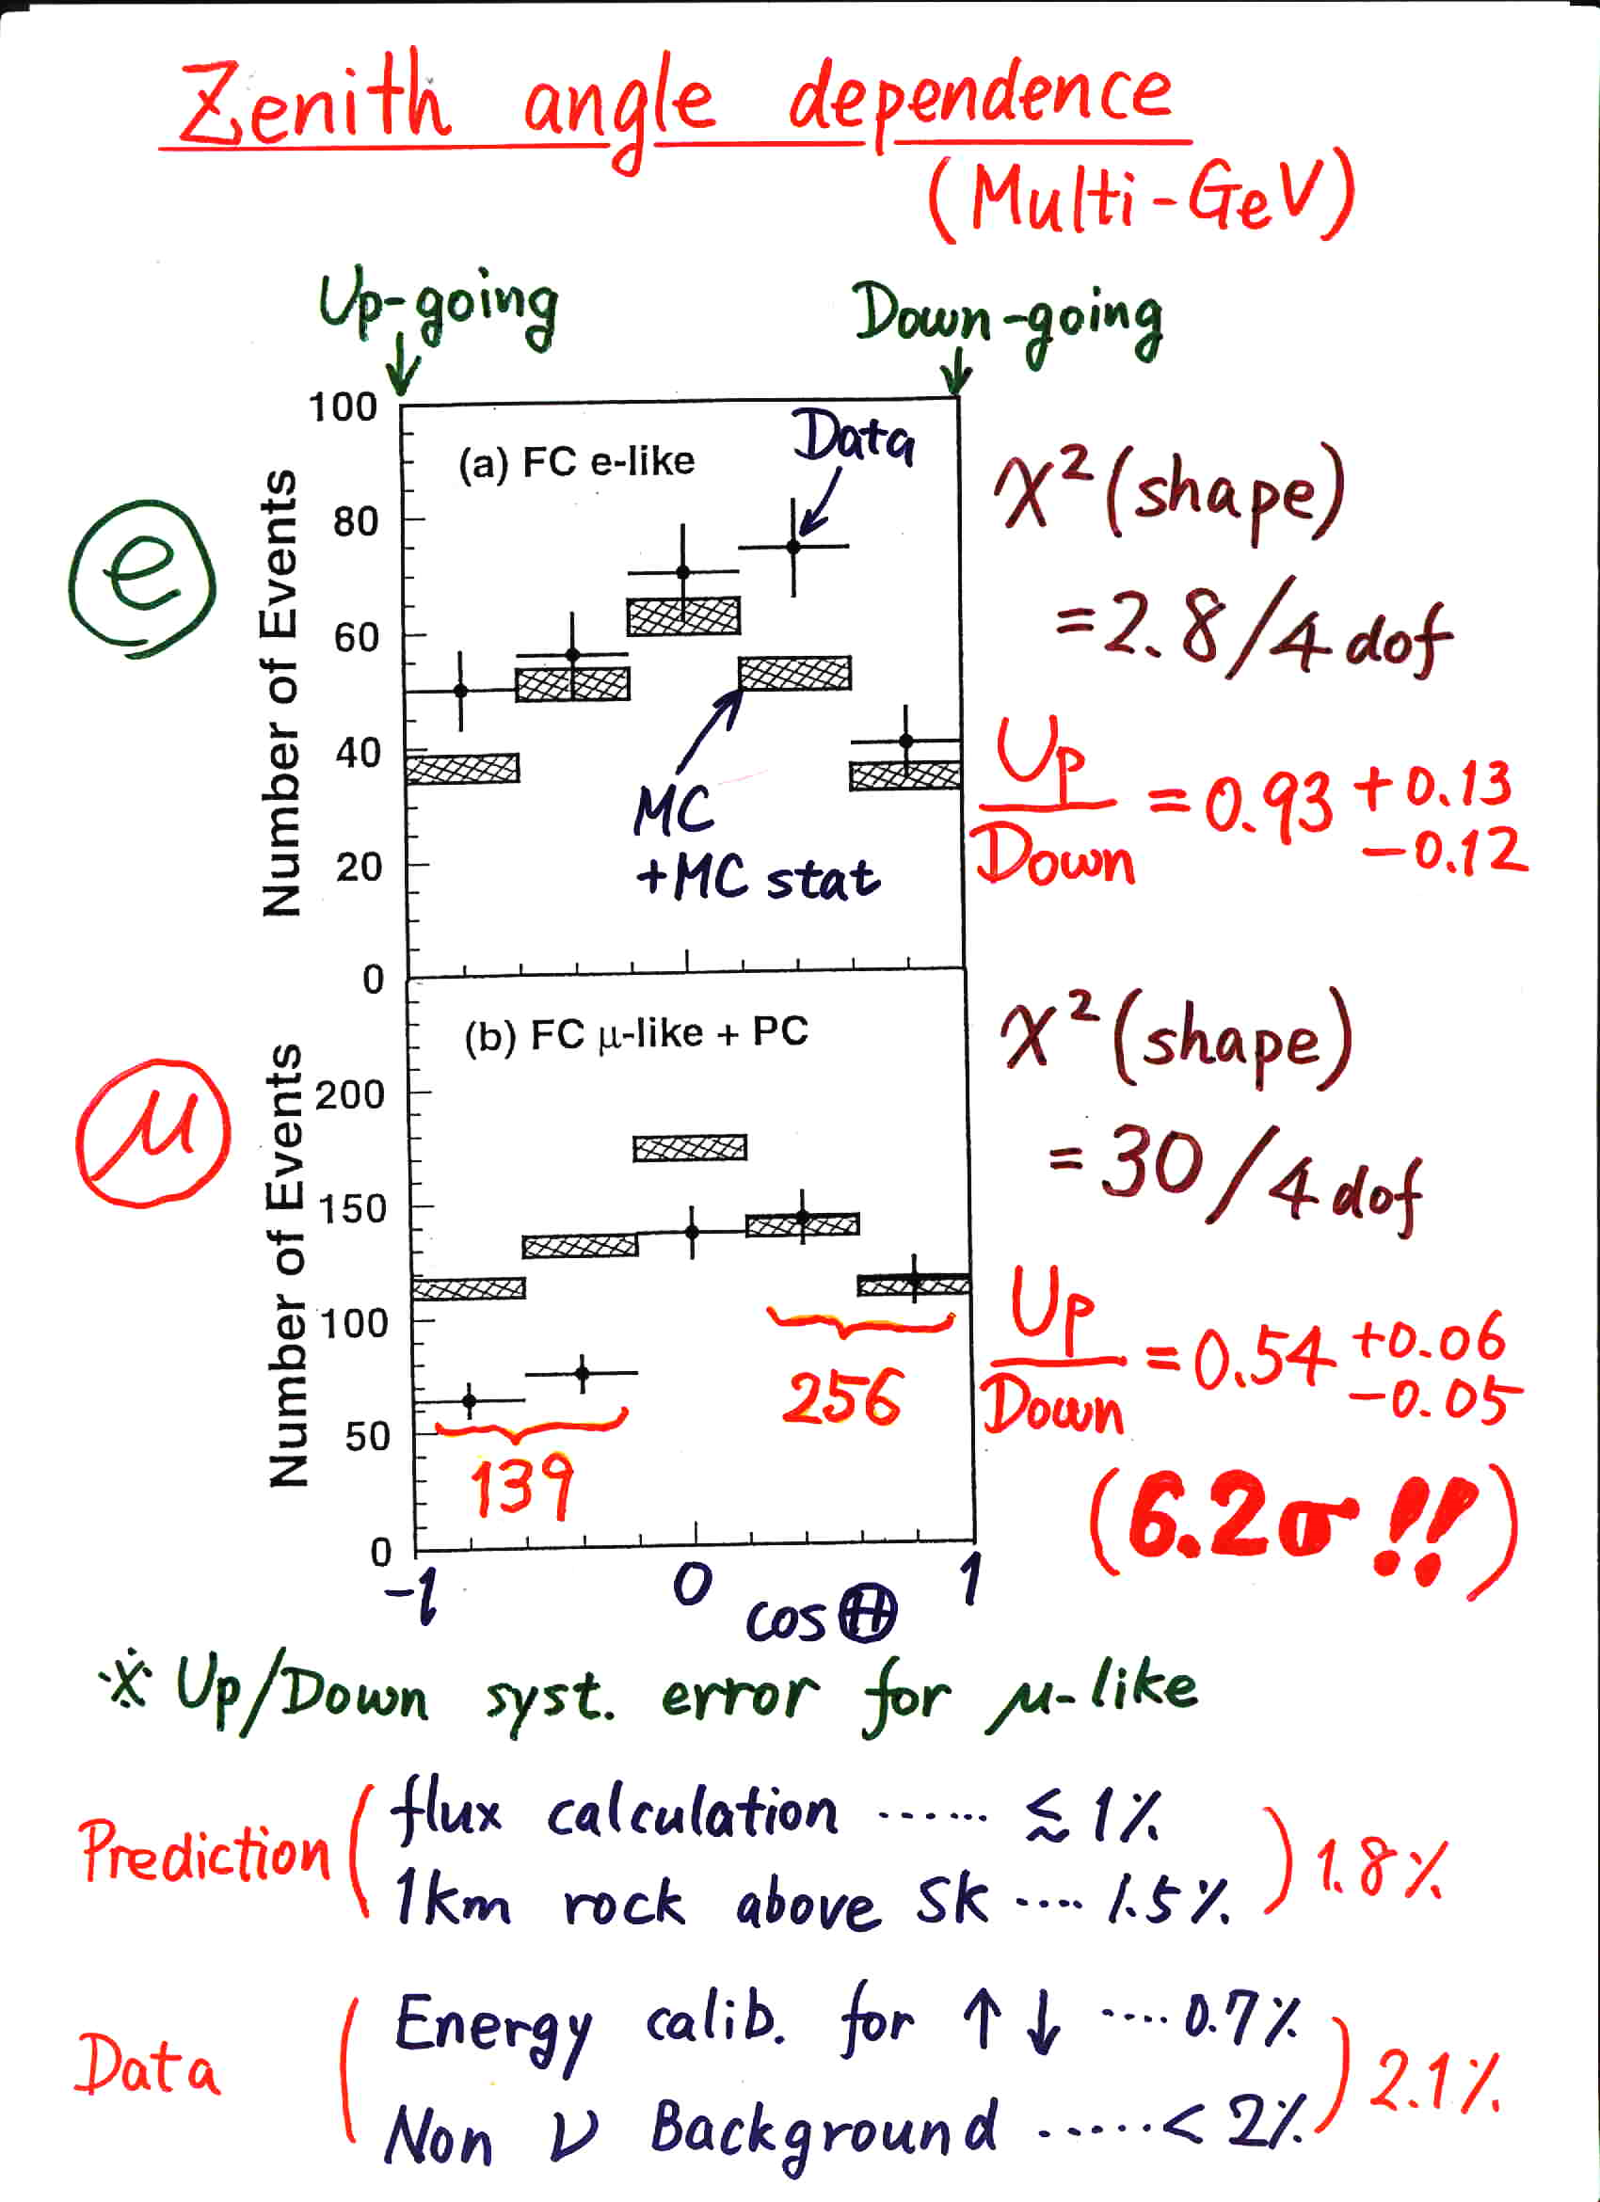
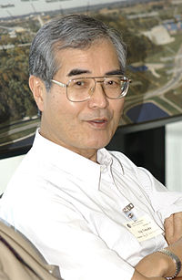
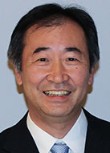
Atmospheric Neutrino Oscillations
Super-Kamiokande @ Neutrino 98
COSMIC RAY
AIR NUCLEUS
PION
MUON
ELECTRON
2 muon-neutrinos
1 electron-neutrino
Discovery of atmospheric
neutrino oscillations
supported by
K2K, MINOS, T2K, NOνA
From Kajita, ICHEP 16
Yoji Totsuka
(1942-2008)
T. Kajita

Slide 4
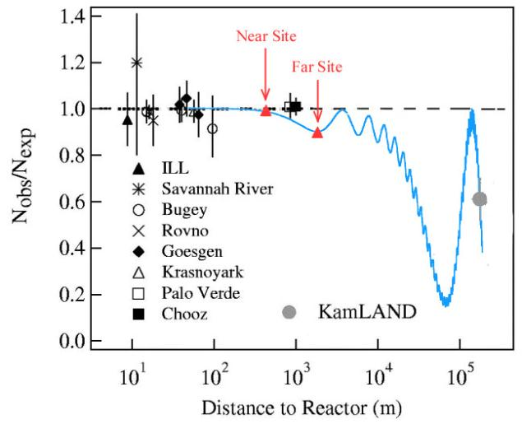
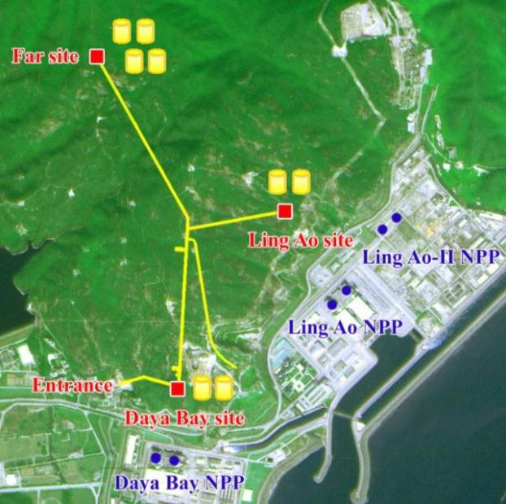
Reactor Neutrino Oscillations
Daya Bay
Double Chooz (far detector):
sin² θ₁₃ = 0.022 ± 0.013
Daya Bay (near + far detectors):
sin² θ₁₃ = 0.024 ± 0.004
RENO (near + far detectors):
sin² θ₁₃ = 0.029 ± 0.006
Dec. 2011
1.7σ
Mar. 2012
5.2σ
Discovery of reactor
neutrino oscillations
Apr. 2012
4.9σ
A complete picture of three-flavor neutrino oscillations!

Slide 5
Current Status of Neutrino Oscillations
Basic neutrino parameters
Esteban et al., 2007.14792, NuFIT 5.0 (2020)
Future neutrino oscillation experiments will measure the octant of θ₂₃, the CP-violating phase δ, and the neutrino mass ordering
The most restrictive bound on absolute neutrino masses is coming from cosmological observations: m₁ + m₂ + m₃ < 0.12 eV (Planck)

Slide 6
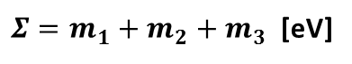
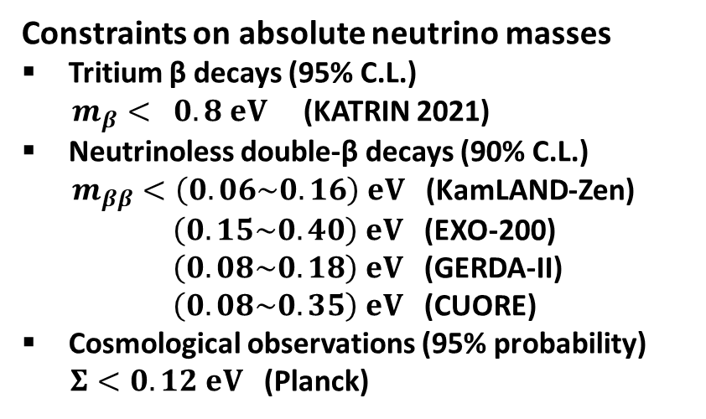
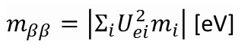
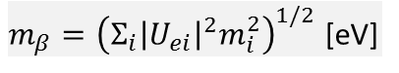
Current Status of Absolute Neutrino Masses
m₁ < m₂ < m₃ (NO) or m₃ < m₁ < m₂ (IO)
$m_{β}={\left(Σ_{i}{\left|U_{ei}\right|}^{2}m_{i}^{2}\right)}^{1/2}$ [eV]
Constraints on absolute neutrino masses
Tritium β decays (95% C.L.)
$m_{β}< 0.8 eV$ (KATRIN 2021)
Neutrinoless double-β decays (90% C.L.)
$m_{ββ}<\left(0.06\sim 0.16\right) eV$ (KamLAND-Zen)
$\left(0.15\sim 0.40\right) eV$ (EXO-200)
$\left(0.08\sim 0.18\right) eV$ (GERDA-II)
$\left(0.08\sim 0.35\right) eV$ (CUORE)
Cosmological observations (95% probability)
$Σ<0.12 eV$ (Planck)
Tritium β decays (KATRIN)
IO
Cosmological Bound
NO
Capozzi et al., 2003.08511
$m_{ββ}=\left|{Σ_{i}U}_{ei}^{2}m_{i}\right|$[eV]
Abazajian et al., 1907.04473
Neutrinoless double-β decays
IO
Cosmological Bound
NO
$Σ=m_{1}+m_{2}+m_{3}$ [eV]

Slide 7
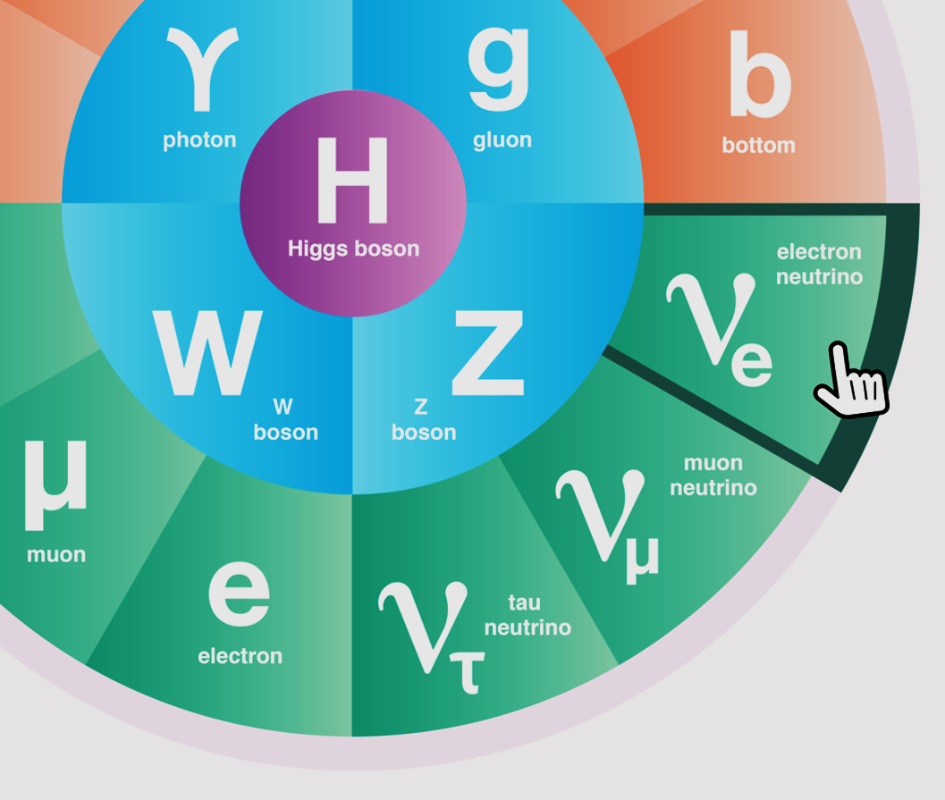
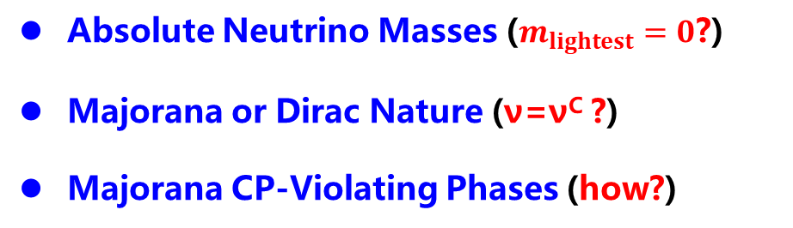
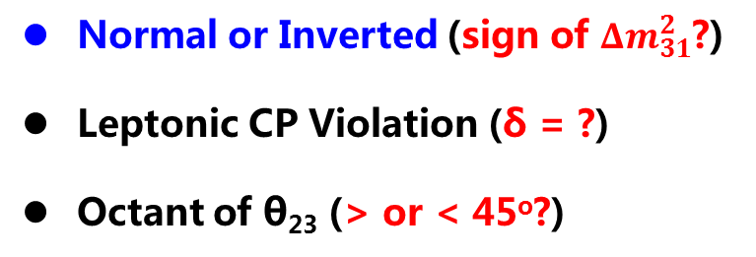
Open Questions in Neutrino Physics
Normal or Inverted (sign of ${Δm}_{31}^{2}$?)
Leptonic CP Violation (δ = ?)
Octant of θ₂₃ (> or < 45º?)
Absolute Neutrino Masses ($m_{lightest}=0$?)
Majorana or Dirac Nature (ν=ν^{C} ?)
Majorana CP-Violating Phases (how?)
Extra Neutrino Species
Exotic Neutrino Interactions
Various LNV & LFV Processes
Leptonic Unitarity Violation
Origin of Neutrino Masses
Flavor Structure (Symmetry?)
Quark-Lepton Connection
Relations to DM, BAU, or NP

Slide 8
Origin of Neutrino Masses
Extend the SM with new particles but keep its gauge symmetries intact
Ohlsson, SZ, Nat. Commun., 2014

Slide 9
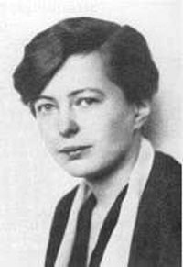
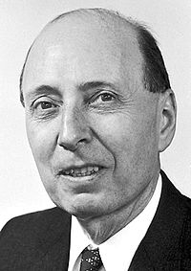
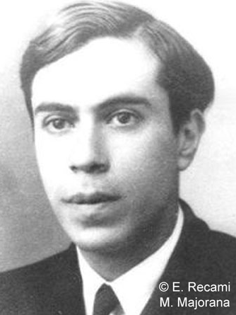
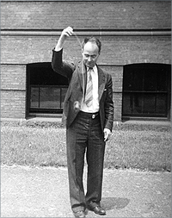
History of 0ν2β Decays
In 1935, Maria Goeppert-Mayer published the first calculation of 2ν2β decay rates based on the Fermi theory (proposed in 1934). It was acknowledged in her paper that Eugene Wigner suggested this problem.
Ettore Majorana
(ν=ν^{C}? 1937)
Wendell Furry
(1907 – 1984)

Slide 10
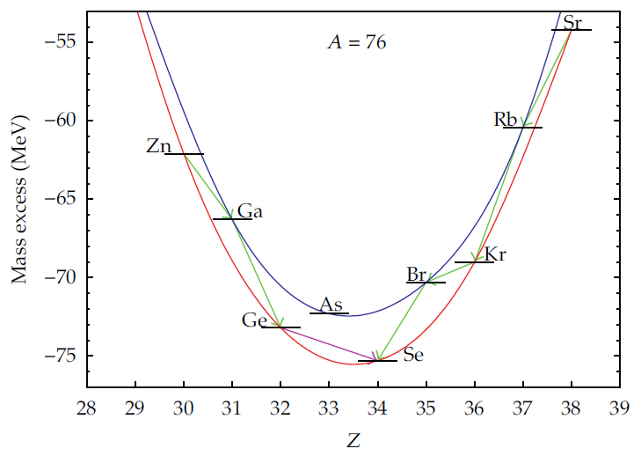
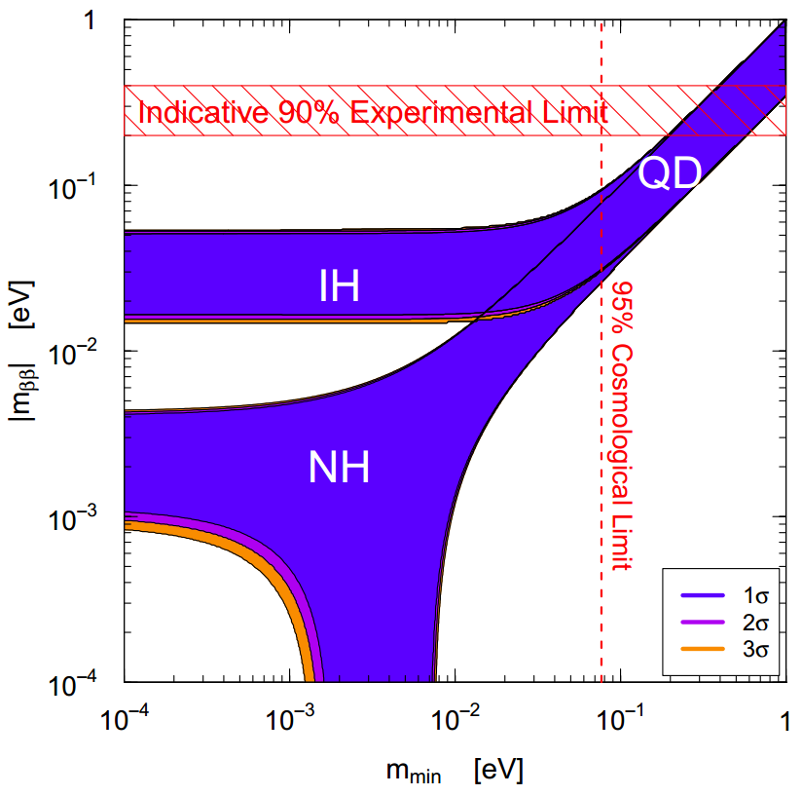
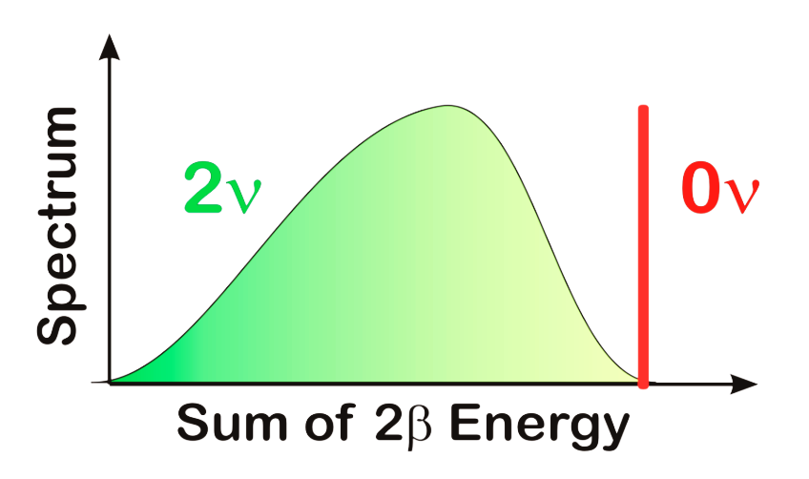
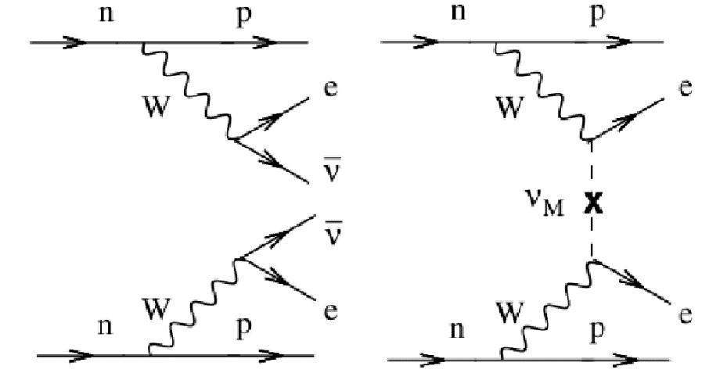
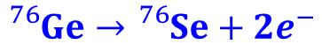
Basics of 0ν2β Decays
$${}_{}^{76}{Ge}→{}_{}^{76}{Se}+2e^{−}$$
Nearly degenerate?
Vanishing
0ν2β mass?
Goeppert-Mayer, 35
Furry, 39
2ν2β
0ν2β

Slide 11
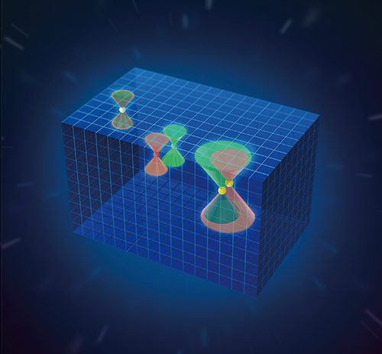
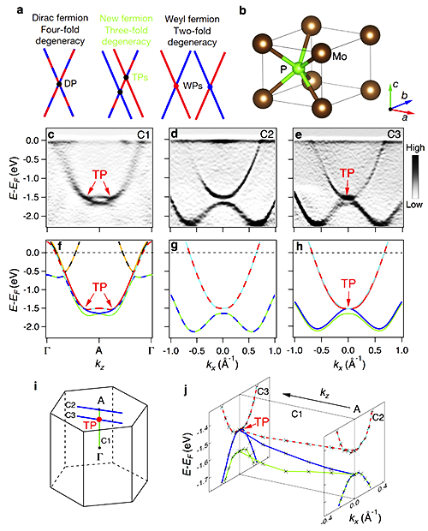
Importance of 0ν2β Decays
★ A new feature of elementary particles: Majorana fermions
Dirac Fermion
Weyl Fermion
New Fermion:
Three-fold
degeneracy
Majorana
zero mode
HOT!!! Weyl, Majorana, Dirac and new fermions in condensed matter physics,
but NOT really elementary particles
doi:10.1038/nature22390

Slide 12
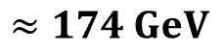
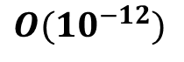
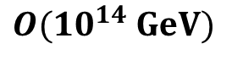
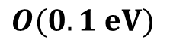
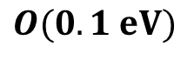
Importance of 0ν2β Decays
★ Discovery of lepton number violation: baryon vs. lepton numbers
Dirac Neutrinos
Majorana Neutrinos
Generate Dirac ν masses in a similar way to that for quarks and charged leptons, after the spontaneous gauge symmetry breaking
Generate tiny Majorana ν masses via the so-called seesaw mechanism
$$≈174 GeV$$
$$O(0.1 eV)$$
$$O({10}^{−12})$$
$$O(0.1 eV)$$
$$O({10}^{14} GeV)$$
Need to introduce additional symmetries to the SM to forbid a Majorana mass for right-handed neutrino singlets
Need to explain a strong hierarchy for the Yukawa couplings of the SM fermions
Retain the SM symmetries
GUT or TeV energy scale?
Guide the theorists to build a model for tiny ν masses

Slide 13
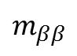
Importance of 0ν2β Decays
★ Constrain ν masses and mixing parameters: Majorana CP phases?
Rodejohann, IJMPE, 2011; JPG, 2012; Bilenky, Giunti, MPLA, 2012; IJMPA, 2015
$$m_{ββ}=m_{1}{|U_{e1}^{}|}^{2}e^{iρ}+m_{2}{|U_{e2}^{}|}^{2}+m_{3}{|U_{e3}^{}|}^{2}e^{iσ}$$
$$m_{ββ}$$
ν mass ordering, lightest ν mass, Majorana CP phases
A unique way to constrain Majorana CP phases?
Xing, Zhao, EPJC, 2017

Slide 14
Schechter-Valle Theorem
Schechter-Valle Theorem (82): If the 0ν2β decay happens, there must exist an effective Majorana neutrino mass term.
Question: How large is such a mass term?
Assumptions: (1) no tree-level neutrino masses; (2) 0ν2β decays are mediated by heavy particles, i.e., short-range interactions:
Pas et al., PLB, 2001
Hadronic currents
leptonic currents

Slide 15
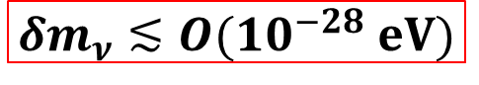
Schechter-Valle Theorem
Current experimental upper bounds on the 0ν2β decay width can be translated into upper limits on the coefficients ϵ_{i}’s
Nonzero quark and electron masses are crucial for us to draw the butterfly diagram, since we don’t know the chirality of (u, d, e)
Take one operator for example:
Upper bound
Duerr, Lindner, Merle, JHEP, 2011
Quantitatively, the 4-loop Majorana mass from the butterfly diagram is EXTREMELY small:
$$δm_{ν}≲O({10}^{−28} eV)$$
Duerr, Lindner, Merle, JHEP, 2011;
Liu, Zhang, Zhou, PLB, 2016
Assume 0ν2β decays are governed by short-distance operators
The Schechter-Valle (Black Box) theorem is qualitatively correct, but the induced Majorana masses are too small to be relevant
for neutrino oscillations
Other mechanisms are needed to generate neutrino masses

Slide 16
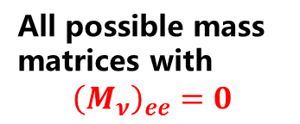
Extended Schechter-Valle Theorem
Hirsch, Kovalenko, Schmidt (06): One-to-one correspondence relation between LNV processes and corresponding elements of the Majorana neutrino mass matrix
Conclusion:
current neutrino oscillation data indicate a finite 0ν2β rate
All possible mass matrices with
$${\left(M_{ν}\right)}_{ee}=0$$
The Majorana neutrino mass matrix A₁ is allowed by oscillation data, leading to a nonzero 0ν2β rate!

Slide 17
Other Lepton-Number-Violating Decays
Meson Decays:
Liu, Zhang, Zhou, PLB, 2016

Slide 18
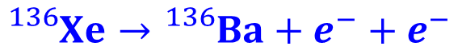
Experimental Sensitivities
$${}_{}^{136}{Xe}→{}_{}^{136}{Ba}+e^{−}+e^{−}$$
Gomez-Cadenas et al., 1109.5155
Light ν mediated 0νββ
The 0νββ-decay half-life
Experimentalists: fix the half-life
Nuclear theorists: calculate NME
Particle theorists: effective mass
ν masses & Majorana CP phases
Phase space
Nuclear Matrix Element
Effective ν mass

Slide 19
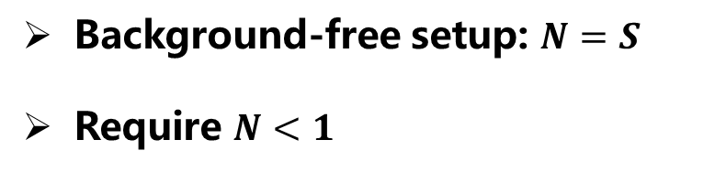
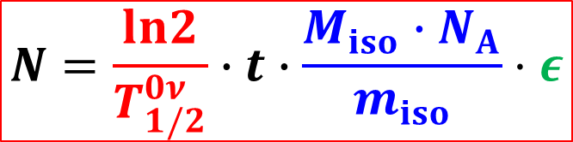
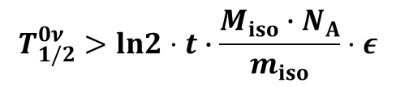
Experimental Sensitivities
How to extract the 0νββ-decay half-life:
$$N=\frac{ln2}{T_{1/2}^{0ν}}∙t∙\frac{{M_{iso}∙N}_{A}}{m_{iso}}⋅ε$$
Number of events
Detection efficiency
Toy model:
Decay rate
Number of nuclei
Background-free setup: $N=S$
Require $N<1$
$$T_{1/2}^{0ν}>ln2⋅t∙\frac{{M_{iso}∙N}_{A}}{m_{iso}}⋅ε$$
Upper limit on effective mass
Realistic case:
exposure
Number of signal events given background B in ROI

Slide 20
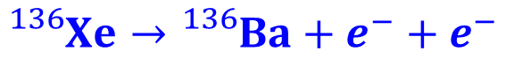
Experimental Sensitivities
$${}_{}^{136}{Xe}→{}_{}^{136}{Ba}+e^{−}+e^{−}$$
G.Y. Huang, SZ, 2010.16281
Rodejohann, 1106.1334
Caldwell et al, 1705.01945
1 meV sensitivity

Slide 21

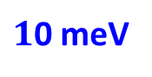
Probe ν Masses & Majorana CP Phases
Jun Cao et al., 1908.08355
IO
$1$0 meV
NO
$1$ meV
Effective ν mass
We assume Majorana neutrinos with NO, and observe no signal events
If this is true even for future 1 meV sensitivity, then what can we learn?

Slide 22
Bayesian Approach
Prior probability
Bayes’ Theorem
normalization
Posterior probability
likelihood
Bayes’ factor
Model selection:
Parameter estimation:
Calculate the evidence
Central idea:
Sivia & Skilling, Data Analysis: A Bayesian Tutorial, 2006
Before including the new experimental data, we have to specify prior info.
Update our knowledge by using the posterior of previous expts. as priors

Slide 23
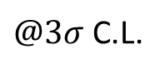
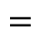
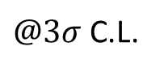

Bayesian Analysis: Masses & Majorana CP Phases
Motivation for two setups
J. Zhao, L.J. Wen, Y.F. Wang, J. Cao, 1610.07143
Setup I: JUNO Xe-LS
$@3σ$ C.L.
Setup II: Ideal scenario
$$=$$
$$=$$
$@3σ$ C.L.

Slide 24
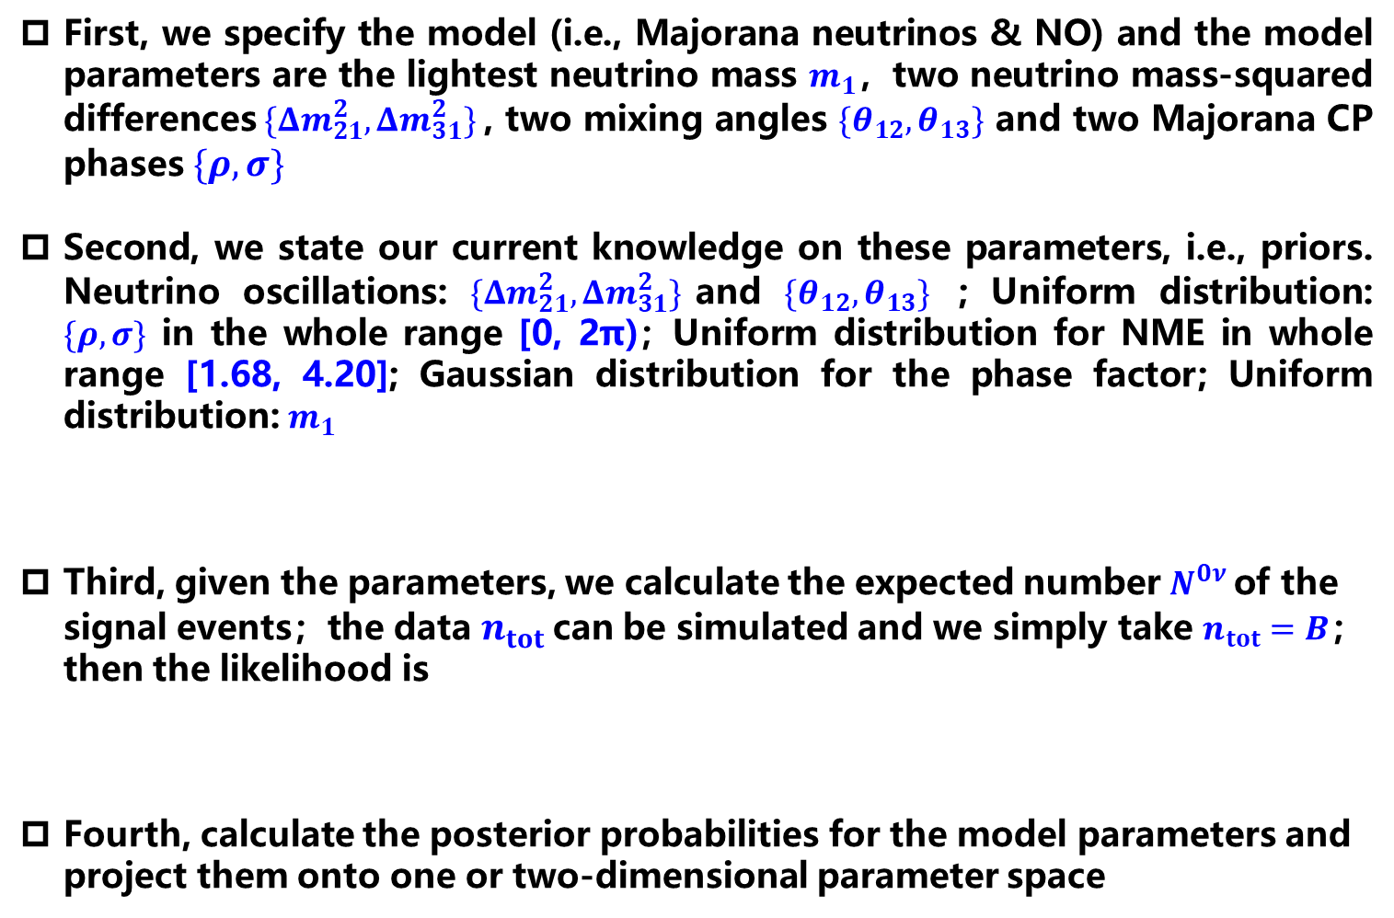
Bayesian Analysis: Masses & Majorana CP Phases
First, we specify the model (i.e., Majorana neutrinos & NO) and the model parameters are the lightest neutrino mass $m_{1}$，two neutrino mass-squared differences$\{Δm_{21}^{2},Δm_{31}^{2}\}$, two mixing angles ${\{θ}_{12},θ_{13}\}$ and two Majorana CP phases $\{ρ, σ\}$
Second, we state our current knowledge on these parameters, i.e., priors. Neutrino oscillations: $\{Δm_{21}^{2},Δm_{31}^{2}\}$and ${\{θ}_{12},θ_{13}\}$ ; Uniform distribution: $\{ρ, σ\}$ in the whole range [0, 2π)；Uniform distribution for NME in whole range [1.68, 4.20]; Gaussian distribution for the phase factor; Uniform distribution: $m_{1}$
Third, given the parameters, we calculate the expected number $N^{0ν}$of the signal events；the data $n_{tot}$ can be simulated and we simply take $n_{tot}=B$；then the likelihood is
Fourth, calculate the posterior probabilities for the model parameters and project them onto one or two-dimensional parameter space
Flat:
Log:

Slide 25

Bayesian Analysis: Masses & Majorana CP Phases
Final Results for Setup-I
G.Y. Huang, SZ, 2010.16281

Slide 26

Bayesian Analysis: Masses & Majorana CP Phases
Final Results for Setup-II
G.Y. Huang, SZ, 2010.16281

Slide 27
Bayesian Analysis: Comparison with Cosmology
Future sensitivity from cosmology
Background-free environment, average NME, and varying total exposure
Better sensitivity to lightest ν mass than future cosmological observations

Slide 28

Bayesian Analysis: Majorana vs. Dirac Neutrinos
If no signals observed, is it possible to exclude Majorana neutrinos?
Setup I: JUNO Xe-LS
Log
NO
Flat
Inconclusive
Log
IO
Jeffreys scale
Flat
Very strong evidence
Setup II: NO case
Strong evidence ln(B_{D/M})=5 requires the total exposure:
$$ξ=1000 ton⋅yr$$

Slide 29
Summary
0ν2β
2ν2β
E_{2β}
The 0ν2β decays offer a feasible and promising way to establish the Majorana nature of massive neutrinos
★ Discovery of a new feature of elementary fermions
★ Discovery of LNV: a guide for theorists
★ Majorana CP Phases
The implications of the Schechter-Valle theorem are discussed and the extended to other LNV processes: a Majorana mass
More efforts on experimental & theoretical sides hopefully help us explore the intrinsic properties of neutrinos

